Slide 1
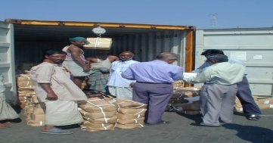
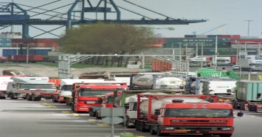
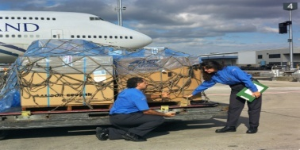
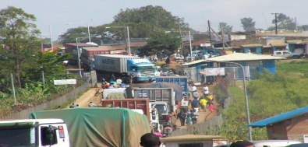
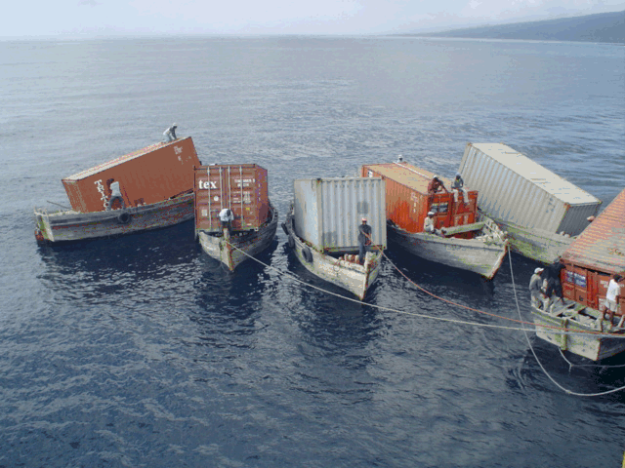
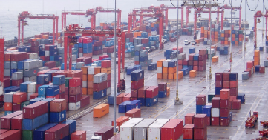



Lao PDR Trade Development Facility
Risk Management Workshop
28 January 2011
Gerard McLinden – Kees Van Der Meer
World Bank
World Bank

Slide 2




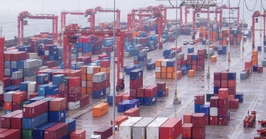

Overview
Context
  Aims of border management
  Drivers for change
  A changing paradigm
International good practice in risk management
Towards SPS risk management in Lao PDR
Capacity building needs
World Bank

Slide 3
Context – Border Management Objectives
To ensure effective and cost efficient compliance with national laws and international commitments relating to the movement of goods and people across national borders. Focus on:
  Protecting the community from harmful imports;
  Revenue collection;
  National security; and
  Trade facilitation (low transaction costs, transparency & predictability)
World Bank

Slide 4
Context – Drivers for Change
Heightened awareness of the costs of inefficient and outdated border formalities
Globalization and continued growth in international trade
Increased investment by the private sector in advanced logistics, inventory control & just in time manufacturing regimes leading to increased expectations for prompt and predictable processing of imports and exports
Greater policy and procedural requirements associated with regional and international commitments
Tougher competition for FDI (comparative data now available)
World Bank

Slide 5
Context – Drivers for Change
Increasing workload and public expectations with static or reduced human and financial resources
Increased competence, qualifications and expectations of staff
Increased awareness of good governance and sound integrity in government
World Bank

Slide 6
Context – A changing paradigm
  Current Practice Future Practice
  Focus on Agency requirements Focus on trade supply chain
  Control focus Facilitation/control balance
  High levels of Physical inspection Intervention by exception
  Focus on the goods Focus on information
  Focus on identifying non-compliance Compliance/non-compliance balance
  One size fits all Flexible solutions for different clients
  Limited use of ICT Extensive use of ICT
  Adversarial relationship with trade Constructive partnership with trade
  Competition between agencies Collaborate border management
  Limited incentives for compliance Strong incentives for compliance
  Limited cooperation with neighbors Extensive cross border cooperation
  Limited operational statistics Clear measures of performance
World Bank

Slide 7
Revenue Generation
Duties; Taxes; Fees
Entry Controls
Dumping; Industry protection
Finance,
Commerce
Patent; Trademark; Copyright
Intellectual Property
Drugs, narcotics; Pornography;
Money laundering; Fraud
Prohibited Transactions
Vehicle safety; road taxes
Transport
Health and Safety
Insect/pest control;
Toxic wastes;
Production processes;
Manufacturing emissions;
Endangered species
Health,
Agriculture,
Industry
Environmental Protection
Health and Safety
Food; Consumer goods;
Animal disease;
Plant disease;
Generic safety
Interior
Entry Controls
Immigration
Military
International Security
Anti-terrorism; Gun controls;
Arm trafficking;
Weapons of mass destruction
Notes:
This is just a list of the government entities involved in international trade
All these organizations exist, believe they have a clear mandate from government, believe they perform roles of great importance to their country, and all have a very keen interest in their own survival

Slide 8
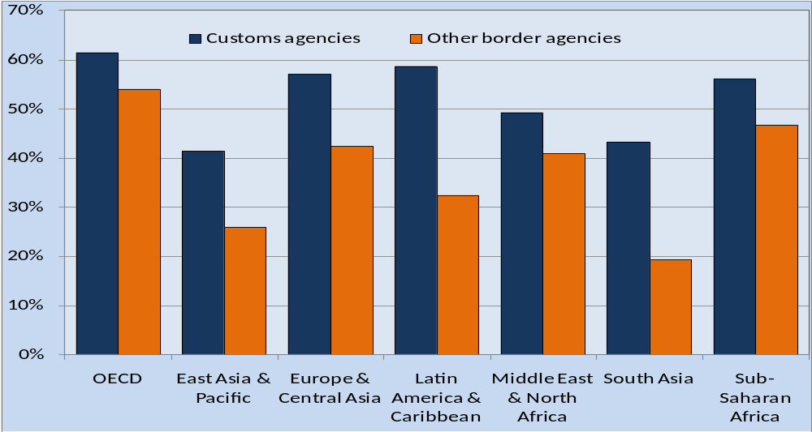
What traders think
Percentage of LPI respondents claiming improvement in Customs and other border agencies since 2005
World Bank

Slide 9
Good Practice in Risk Management
  Manifest (carrier) and Declaration (owner or Agent) information is provided by the trading community either manually or electronically via either a ‘single window’ or directly to Customs
  The Customs system performs the initial screening of manifest and declaration information and determines the status of consignments based on established risk profiles (developed by or in full cooperation with all relevant agencies)
World Bank

Slide 10
Good Practice in Risk Management
  Customs will then either:
    clear the consignment (once duties, taxes and other regulatory requirements have been met)
    undertake specific action including documentary check, scanning, partial or full physical examination, and delegated tasks on behalf of other agencies
    refer the consignment to other specialized agencies for specific action
World Bank

Slide 11
Good Practice in Risk Management
  Where there is a need for more than one agency to inspect goods, this is coordinated and undertaken only once
  In all cases, the decision to inspect any consignment must be based on identified risk
  Default channel should be green not red
  Results of all inspections are recorded, analysed and fed back into the risk management system
World Bank

Slide 12
Some arguments for not using risk management
  We need IT and more equipment to do risk management properly
  If we don’t check everything we will get in trouble if anything slips through
  Detection rates will go down
  Examining everything is a deterrent
  Our trading partners demand that we inspect everything
  Even good traders can go bad if not checked
World Bank

Slide 13
Some arguments for not using risk management
  Post release controls can’t work here
  We understand the key principles but the other agencies don’t
  We can’t trust the other agencies to inspect goods on our behalf
  Revenue is important for the country – valuation fraud is rife
  Our fees are based on performing inspections
World Bank

Slide 14
Some arguments for not using risk management
  We could use risk management if our traders were not such crooks
  We don’t have the information to assess risk and develop profiles
  We need much more training and time to develop our expertise
World Bank

Slide 15
SPS

Slide 16
Towards SPS risk management in Lao PDR
Adoption of risk-based management in SPS is behind Customs
What are the issues?
What can be done?
How can efforts in SPS and other agencies be better aligned to achieve higher efficiency in clearance?

Slide 17
Rationale for risk-based SPS management
Wise use of public resources
  Why spend same effort on high and low risk shipments?
SPS/TBT principle: Health protection measures should be proportionate to risk
Trade facilitation: lower transaction cost for compliant traders

Slide 18
WTO’s non-discrimination and transparency principles
Countries can put restrictions on products with health risks, but…..
Non-discrimination between
  foreign and domestic producers
  producers in different countries
Import of pests and diseases that are already endemic is not a risk
Same food standards for import and domestic market
Transparency required about a country’s food safety, plant and animal disease situation

Slide 19
Capacities needed for risk management
Staff with knowledge about
  pests, diseases, food safety hazards, epidemiology, pathways of health hazards, etc
  containment, treatment, eradication
Information to determine health risks of imported goods through
  monitoring, surveillance, inspection, diagnostics and testing, internet etc.
  gather information about health in country of origin
Information storage in (ICT) data bases

Slide 20
Steps in risk management
Establish risk profiles for imported products – e.g. low, medium, high; (or more stratified)
  many factors involved: including kind of product, intended use, origin, certification, reputation of producer/trader
Risk assessment
  for market access decisions, e.g. for first-time imports, in case of outbreaks
  coping with new or unaddressed risks
Risk management decisions: allow, reject, allow with conditions
  Conditions can include, post-harvest treatment, quarantine, guarantees from competent authorities, traceability, etc.

Slide 21
Risk management on current imports
Based on risk profile and market access conditions
  incidence of control measures differs
  controls in many cases better through surveillance in domestic markets, warehouses etc. than on border
Good training of staff, inspection manuals, instructions about priorities
Rule of law: legal and regulatory framework needed to define powers of agencies and inspectors, and rights and obligations of traders
Operational budget for inspection, sampling, testing, diagnostics

Slide 22
Facilitation of exports
Requires same capacities, though applied in response of requirements of importers
Additional capacities include certification and accreditation
Respond to requests for information

Slide 23
Scope and sophistication of risk management
Can be expanded (at cost)
  Ranges of pests, diseases, food safety parameters to be controlled
  Developing pest- and disease-free zones; compartmentalization
  Detail in risk assessment
  Efforts to achieve market access for certain products in demanding markets
  Promoting Good Agricultural Practice (GAP), Good Manufacturing Practice (GMP), Hazard Analysis and Critical Points (HACCP), ISO 17025 for laboratories etc.
  Active participation in alert systems e.g. INFOSAN, ARASFF, OIE, IPPC

Slide 24
Alignment and Cooperation
How can efforts in SPS and other agencies be better aligned to achieve higher efficiency in the clearance process?
  Work towards E-commerce and Single Window
  Adoption of suitable ICT and standardized data definitions for information exchanges;
  Agreements between the lead and other agencies about delegation of tasks: needs legal basis;
  Although each agency keeps basic responsibility for risk management in its own domain, agreement is necessary about coordination of inspections and other measures.

Slide 25
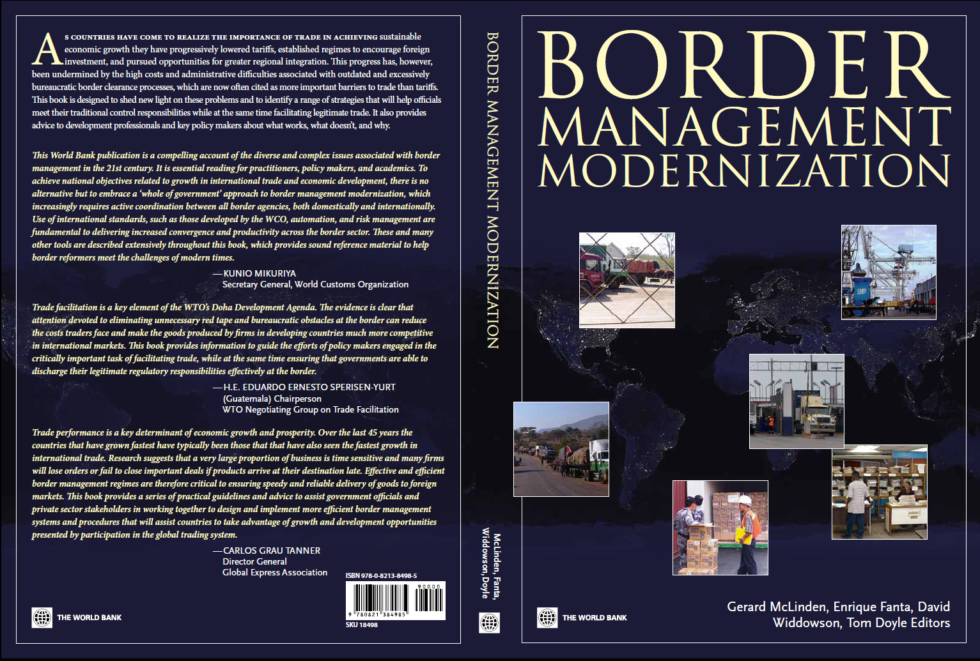
Our next contribution ….

Slide 26
For further information:
  Gerard McLinden gmclinden@worldbank.or
  Toni Matsudaira tmatsudaira@worldbank.org
  Kees Van der Meer cljvdmeer@gmail.com

